Slide 1
Internet Applications

Slide 2
Contents
HTML
XML
HTTP
Dynamically Generated Web Contents
Common Gateway Interface

Slide 3
HTML
HTML (HyperText Markup Language) is the most basic building block of the Web. It defines the meaning and structure of web content. Other technologies besides HTML are generally used to describe a web page's appearance/presentation (CSS) or functionality/behavior (JavaScript).
“Hypertext” refers to links that connect web pages to one another, either within a single website or between websites. Links are a fundamental aspect of the Web. By uploading content to the Internet and linking it to pages created by other people, you become an active participant in the World Wide Web.

Slide 4
HTML
HTML uses "markup" to annotate text, images, and other content for display in a Web browser. HTML markup includes special "elements" such as <head>, <title>, <body>, <header>, <footer>, <article>, <section>, <p>, <div>, <span>, <img>, <aside>, <audio>, <canvas>, <datalist>, <details>, <embed>, <nav>, <search>, <output>, <progress>, <video>, <ul>, <ol>, <li> and many others.

Slide 5
HTML
An HTML element is set off from other text in a document by "tags", which consist of the element name surrounded by "<" and ">".
The name of an element inside a tag is case-insensitive. That is, it can be written in uppercase, lowercase, or a mixture.
For example, the <title> tag can be written as <Title>, <TITLE>, or in any other way.
However, the convention and recommended practice is to write tags in lowercase.

Slide 6
XML
XML is a software- and hardware-independent tool for storing and transporting data.
XML stands for eXtensible Markup Language
XML is a markup language much like HTML
XML was designed to store and transport data
XML was designed to be self-descriptive
XML is a W3C Recommendation

Slide 7
The Difference Between XML and HTML
XML and HTML were designed with different goals:
XML was designed to carry data - with focus on what data is
HTML was designed to display data - with focus on how data looks
XML tags are not predefined like HTML tags are

Slide 8
XML Does Not Use Predefined Tags
The XML language has no predefined tags.
The tags in the example above (like <to> and <from>) are not defined in any XML standard. These tags are "invented" by the author of the XML document.
HTML works with predefined tags like <p>, <h1>, <table>, etc.
With XML, the author must define both the tags and the document structure.

Slide 9
XML is Extensible
Most XML applications will work as expected even if new data is added (or removed).
Imagine an application designed to display the original version of note.xml (<to> <from> <heading> <body>).
Then imagine a newer version of note.xml with added <date> and <hour> elements, and a removed <heading>.

Slide 10
HTTP
HTTP stands for Hyper Text Transfer Protocol
WWW is about communication between web clients and servers
Communication between client computers and web servers is done by sending HTTP Requests and receiving HTTP Responses
The World Wide Web is about communication between web clients and web servers.
Clients are often browsers (Chrome, Edge, Safari), but they can be any type of program or device.
Servers are most often computers in the cloud.

Slide 11
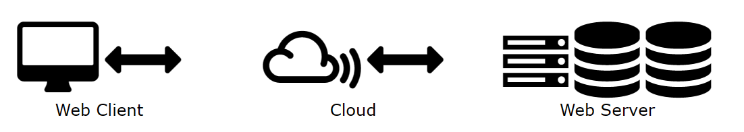
HTTP Request / Response
Communication between clients and servers is done by requests and responses:
A client (a browser) sends an HTTP request to the web
A web server receives the request
The server runs an application to process the request
The server returns an HTTP response (output) to the browser
The client (the browser) receives the response

Slide 12
The HTTP Request Circle
A typical HTTP request / response circle:
The browser requests an HTML page. The server returns an HTML file.
The browser requests a style sheet. The server returns a CSS file.
The browser requests a JPG image. The server returns a JPG file.
The browser requests JavaScript code. The server returns a JS file
The browser requests data. The server returns data (in XML or JSON).

Slide 13
XHR - XML Http Request
All browsers have a built-in XMLHttpRequest Object (XHR).
XHR is a JavaScript object that is used to transfer data between a web browser and a web server.
XHR is often used to request and receive data for the purpose of modifying a web page.
Despite the XML and Http in the name, XHR is used with other protocols than HTTP, and the data can be of many different types like HTML, CSS, XML, JSON, and plain text.
The XHR Object is a Web Developers Dream, because you can:
Update a web page without reloading the page
Request data from a server - after the page has loaded
Receive data from a server - after the page has loaded
Send data to a server - in the background

Slide 14
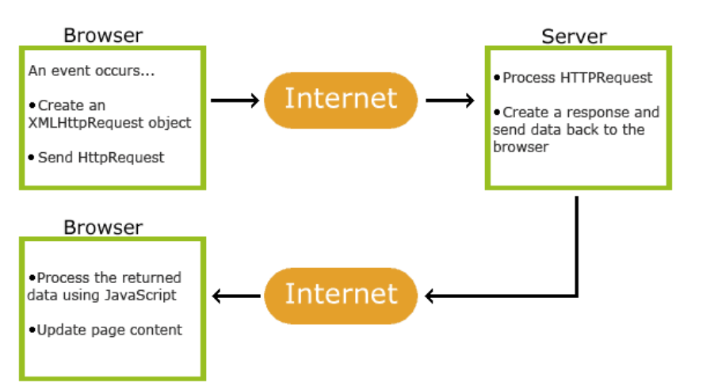
XHR - XML Http Request
The XHR Object is the underlying concept of AJAX and JSON:

Slide 15
Dynamically Generated Web Contents
Dynamic content is web content that adjusts in real time to the user’s behavior, preferences, and interactions. This can be done by showing users things relevant to their location or previous visits. Here are some key benefits of the dynamic content:
Enhanced Personalization: Content adapts to individual user preferences.
Increased Conversion Rates: More targeted user engagement.
Improved User Experience: Content resonates more effectively with users.
Efficient Content Management: Streamlines the creation process.
Data-Driven Insights: Gathers useful data to refine strategies.

Slide 16
What Is Dynamic Content?
Dynamic content (aka adaptive content) refers to web content that changes based on users’ behavior, preferences, and interests.
It refers to websites as well as e-mail content and is generated at the moment a user requests a page.
Dynamic content is personalized and adapts based on the data you have about the user and on the access time, its goal being to deliver an engaging and satisfying online experience for the visitor.
Generally powered by applications and scripts, dynamic content works in tandem with static content.

Slide 17
What Is Dynamic Content?
A classical example is the HTML content of a landing page or of an e-mail that changes to display information that is relevant for the viewer based on location or previous interactions with the website.
Another example of dynamically generated content is an e-mail where the user’s name is retrieved from the database and inserted automatically via HTML text.

Slide 18
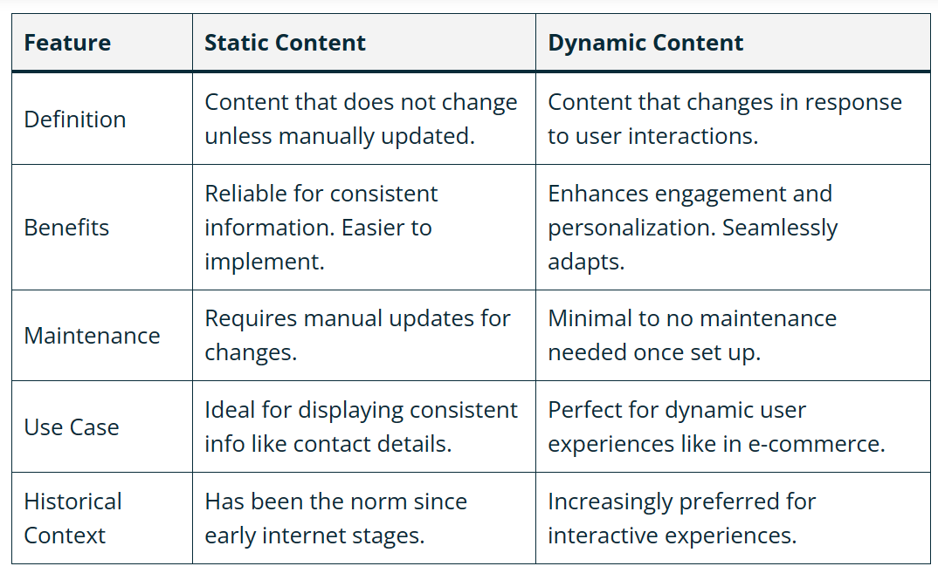
Dynamic Content vs. Static Content

Slide 19
Common Gateway Interface
The Common Gateway Interface (CGI) is a standard that facilitates communication between web servers and external databases or information sources.
It acts as middleware, allowing web servers to interact with applications that process data and send back responses.
The CGI standard was defined by the World Wide Web Consortium (W3C) and specifies how a program interacts with a Hyper Text Transfer Protocol

Slide 20
Features of CGI:
It is a very well-defined and supported standard.
CGI scripts are generally written in languages such as Perl, C, or shell scripts. For example, a simple Perl script could be used to process form data submitted from a web page and generate a dynamic response.
CGI allows applications to interface with HTML, enabling dynamic content generation for web pages. For example, a CGI script can be used to fetch data from a database and generate dynamic HTML content for display on a web page.
CGI is the best method to create a counter because it is currently the quickest
CGI standard is generally the most compatible with today’s browsers

Slide 21
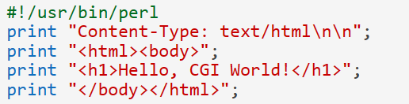
Example
Here is an example of a simple CGI script written in Perl that prints "Hello, CGI World!" as an HTML document:
The first line of the script indicates the location of the Perl interpreter.
The second line prints the content type header, followed by a blank line.
The rest of the script prints the HTML content.

